Slide 1
ARTIFICIAL INTELLIGENCE
Agent

Slide 2
Why study AI
Cognitive Science: As a way to understand how natural minds and mental phenomena work
e.g., visual perception, memory, learning, language, etc.
Philosophy: As a way to explore some basic and interesting (and important) philosophical questions
e.g., the mind body problem, what is consciousness, etc.
Engineering: To get machines to do a wider variety of useful things
e.g., understand spoken natural language, recognize individual people in visual scenes, find the best travel plan for your vacation, etc.

Slide 3
Why study AI
The exciting new effort to make computers thinks … machine with minds, in the full and literal sense”
(Haugeland 1985)
“The study of mental faculties through the use of computational models”
(Charniak et al. 1985)
“The art of creating machines that perform functions that require intelligence when performed by people” (Kurzweil, 1990)
A field of study that seeks to explain and emulate intelligent behavior in terms of computational processes” (Schalkol, 1990)
Systems that think like humans
Systems that think rationally
Systems that act like humans
Systems that act rationally

Slide 4
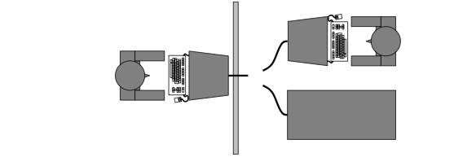
Systems that act like humans
When does a system behave intelligently?
Turing (1950) Computing Machinery and Intelligence
Operational test of intelligence: imitation game
Test still relevant now, yet might be the wrong question.
Requires the collaboration of major components of AI: knowledge, reasoning, language understanding, learning, …

Slide 5
Systems that think like humans
How do humans think?
Requires scientific theories of internal brain activities (cognitive model):
Level of abstraction? (knowledge or circuitry?)
Validation?
Predicting and testing human behavior
Identification from neurological data
Cognitive Science vs. Cognitive neuroscience.
Both approaches are now distinct from AI
Share that the available theories do not explain anything resembling human intelligence.
Three fields share a principal direction.

Slide 6
Systems that think rationally
Capturing the laws of thought
Aristotle: What are ‘correct’ argument and thought processes?
Correctness depends on irrefutability of reasoning processes.
This study initiated the field of logic.
The logicist tradition in AI hopes to create intelligent systems using logic programming.
Problems:
Not all intelligence is mediated by logic behavior
What is the purpose of thinking? What thought should one have?

Slide 7
System that act rationally
Rational behavior: “doing the right thing”
The “Right thing” is that what is expected to maximize goal achievement given the available information.
Can include thinking, yet in service of rational action.
Action without thinking: e.g. reflexes.
Two advantages over previous approaches:
More general than law of thoughts approach
More amenable to scientific development.
Yet rationality is only applicable in ideal environments.
Moreover rationality is not a very good model of reality.

Slide 8
Rational Agents
An agent is an entity that perceives and acts
This course is about designing rational agents
An agent is a function from percept histories to actions:
For any given class of environments and task we seek the agent (or class of agents) with the best performance.
Problem: computational limitations make perfect rationality unachievable.

Slide 9
AI Prehistory
Philosophy Logic, methods of reasoning, mind as physical system foundations of learning, language, rationality
Mathematics Formal representation and proof algorithms, computation, (un)decidability, (in)tractability, probability
Economics utility, decision theory
Neuroscience physical substrate for mental activity
Psychology phenomena of perception and motor control, experimental techniques
Computer building fast computers engineering
Control theory design systems that maximize an objective function over time
Linguistics knowledge representation, grammar

Slide 10
History of AI
1943 McCulloch & Pitts: Boolean circuit model of brain
1950 Turing's "Computing Machinery and Intelligence"
1956 Dartmouth meeting: "Artificial Intelligence" adopted
1952—69 Look, Ma, no hands!
1950s Early AI programs, including Samuel's checkers program, Newell & Simon's Logic Theorist, Gelernter's Geometry Engine
1965 Robinson's complete algorithm for logical reasoning
1966—73 AI discovers computational complexity Neural network research almost disappears
1969—79 Early development of knowledge-based systems
1980-- AI becomes an industry
1986-- Neural networks return to popularity
1987-- AI becomes a science
1995-- The emergence of intelligent agents

Slide 11
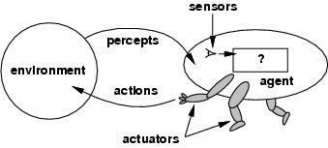
Agent and environments
Agents include human, robots, softbots, thermostats, etc.
The agent function maps percept sequence to actions
An agent can perceive its own actions, but not always it effects.
The agent function will internally be represented by the agent program.
The agent program runs on the physical architecture to produce f.

Slide 12
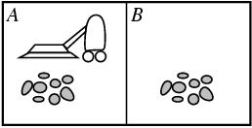
The vacuum-cleaner world
Environment: square A and B
Percepts: [location and content] e.g. [A, Dirty]
Actions: left, right, suck, and no-op

Slide 13
Vacuum-cleaner
Percept sequence | Action
[A,Clean] | Right
[A, Dirty] | Suck
[B, Clean] | Left
[B, Dirty] | Suck
[A, Clean],[A, Clean] | Right
[A, Clean],[A, Dirty] | Suck
… | …

Slide 14
Rational agent
What is rational depends on:
Performance measure - The performance measure that defines the criterion of success
Environment - The agents prior knowledge of the environment
Actuators - The actions that the agent can perform
Sensors - The agent’s percept sequence to date
We’ll call all this the Task Environment (PEAS)

Slide 15
Vacuum Agent PEAS
Performance Measure: minimize energy consumption, maximize dirt pick up. Making this precise: one point for each clean square over lifetime of 1000 steps.
Environment: two squares, dirt distribution unknown, assume actions are deterministic and environment is static (clean squares stay clean)
Actuators: Left, Right, Suck, NoOp
Sensors: agent can perceive its location and whether location is dirty

Slide 16
Automated taxi driving system
Performance Measure: Maintain safety, reach destination, maximize profits (fuel, tire wear), obey laws, provide passenger comfort, …
Environment: U.S. urban streets, freeways, traffic, pedestrians, weather, customers, …
Actuators: Steer, accelerate, brake, horn, speak/display, …
Sensors: Video, sonar, speedometer, odometer, engine sensors, keyboard input, microphone, GPS, …

Slide 17
Medical diagnosis system
Performance measure: Healthy patient, minimize costs, lawsuits
Environment: Patient, hospital, staff
Actuators: Screen display (questions, tests, diagnoses, treatments, referrals) Sensors: Keyboard (entry of symptoms, findings, patient's answers)

Slide 18
Part-picking robot
Performance measure: Percentage of parts in correct bins
Environment: Conveyor belt with parts, bins
Actuators: Jointed arm and hand
Sensors: Camera, joint angle sensors

Slide 19
Interactive English tutor
Performance measure: Maximize student's score on test
Environment: Set of students
Actuators: Screen display (exercises, suggestions, corrections)
Sensors: Keyboard

Slide 20
Autonomy
A system is autonomous to the extent that its own behavior is determined by its own experience.
Therefore, a system is not autonomous if it is guided by its designer according to a priori decisions.
To survive, agents must have:
Enough built-in knowledge to survive.
The ability to learn.

Slide 21
Properties of environments
Fully Observable/Partially Observable
If an agent’s sensors give it access to the complete state of the environment needed to choose an action, the environment is fully observable.
Such environments are convenient, since the agent is freed from the task of keeping track of the changes in the environment.
Deterministic/Stochastic
An environment is deterministic if the next state of the environment is completely determined by the current state of the environment and the action of the agent.
In a fully observable and deterministic environment, the agent need not deal with uncertainty.

Slide 22
Properties of environments
Static/Dynamic.
A static environment does not change while the agent is thinking.
The passage of time as an agent deliberates is irrelevant.
The agent doesn’t need to observe the world during deliberation.
Discrete/Continuous.
If the number of distinct percepts and actions is limited, the environment is discrete, otherwise it is continuous.

Slide 23
Examples
 | Fully Observable | Deterministic | Static | Discrete
Solitaire | No | Yes | Yes | Yes
Backgammon | Yes | No | Yes | Yes
Taxi driving | No | No | No | No
Internet shopping | No | No | No | No
Medical diagnosis | No | No | No | No

Slide 24
Agents
Four basic kind of agent programs will be discussed:
Simple reflex agents
Model-based reflex agents
Goal-based agents
Utility-based agents
All these can be turned into learning agents.

Slide 25
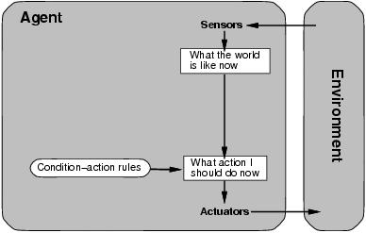
Simple reflex
Select action on the basis of only the current percept.
E.g. the vacuum-agent
Large reduction in possible percept/action situations(next page).
Implemented through condition-action rules
If dirty then suck

Slide 26
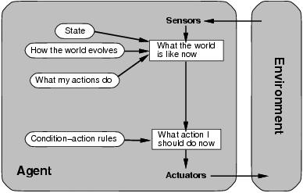
Model-based
To tackle partially observable environments.
Maintain internal state
Over time update state using world knowledge
How does the world change.
How do actions affect world.
⇒ Model of World

Slide 27
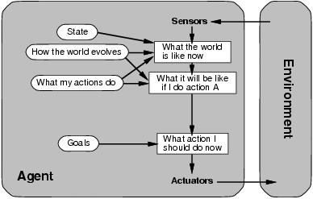
Goal-based
The agent needs a goal to know which situations are desirable.
Things become difficult when long sequences of actions are required to find the goal.
Typically investigated in search and planning research.
Major difference: future is taken into account
Is more flexible since knowledge is represented explicitly and can be manipulated.

Slide 28
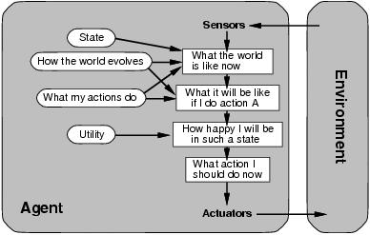
Utility-based
Certain goals can be reached in different ways.
Some are better, have a higher utility.
Utility function maps a (sequence of) state(s) onto a real number.
Improves on goals:
Selecting between conflicting goals
Select appropriately between several goals based on likelihood of success.

Slide 29
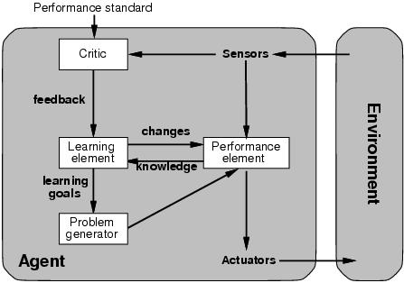
Learning
All previous agent-programs describe methods for selecting actions.
Yet it does not explain the origin of these programs.
Learning mechanisms can be used to perform this task.
Teach them instead of instructing them.
Advantage is the robustness of the program toward initially unknown environments.
Learning element: introduce improvements in performance element.
Critic provides feedback on agents performance based on fixed performance standard.
Performance element: selecting actions based on percepts.
Corresponds to the previous agent programs
Problem generator: suggests actions that will lead to new and informative experiences.
Exploration vs. exploitation

Slide 30
Summary
An agent perceives and acts in an environment, has an architecture, and is implemented by an agent program.
Task environment – PEAS (Performance, Environment, Actuators, Sensors)
An ideal agent always chooses the action which maximizes its expected performance, given its percept sequence so far.
An autonomous learning agent uses its own experience rather than built-in knowledge of the environment by the designer.
An agent program maps from percept to action and updates internal state.
Reflex agents respond immediately to percepts.
Goal-based agents act in order to achieve their goal(s).
Utility-based agents maximize their own utility function.
Representing knowledge is important for successful agent design.
The most challenging environments are not fully observable, nondeterministic, dynamic, and continuous

Slide 31
Reference
Russel, Stuart J., Peter Norvig, "Artificial Intelligence, a modern approach“, Second Edition, Prentice Hall, New Jersey, 2003.

Slide 32
TERIMA KASIH

